Slide 1
Website design project
Prepared by: WONG RONG XIN

Slide 2
Intro of tourism website
The website design for tourism shall develop an attractive and user-friendly website especially for the navigation parts that will form the basis of presenting to visitors all travel destinations, attractions and services. That's cardinal in inspiring visits, planning and bookings, availing them with photos and guides that make them comfortable to browse my website.

Slide 3
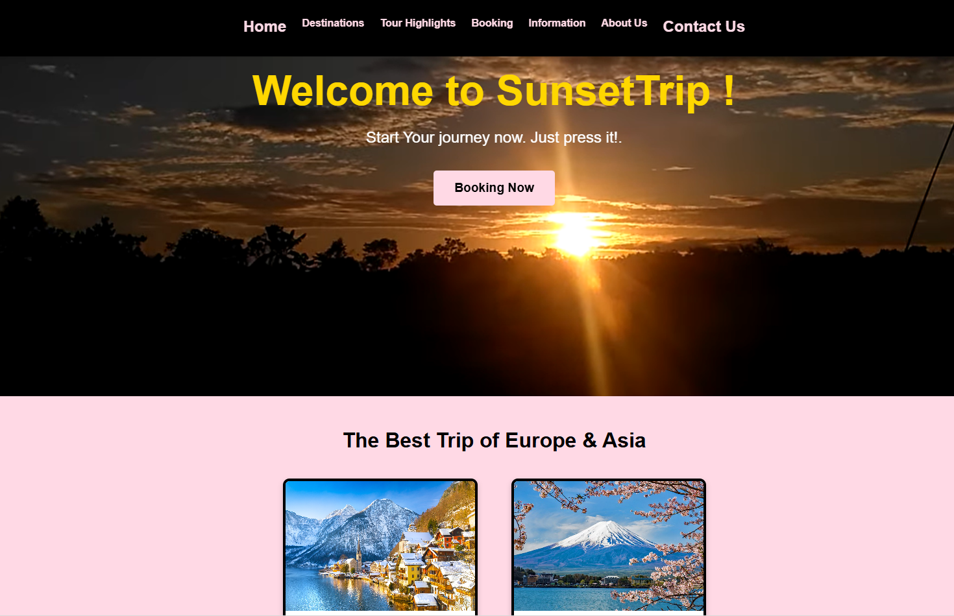
First webpage
Introduce about this website and what services will be provided.

Slide 4
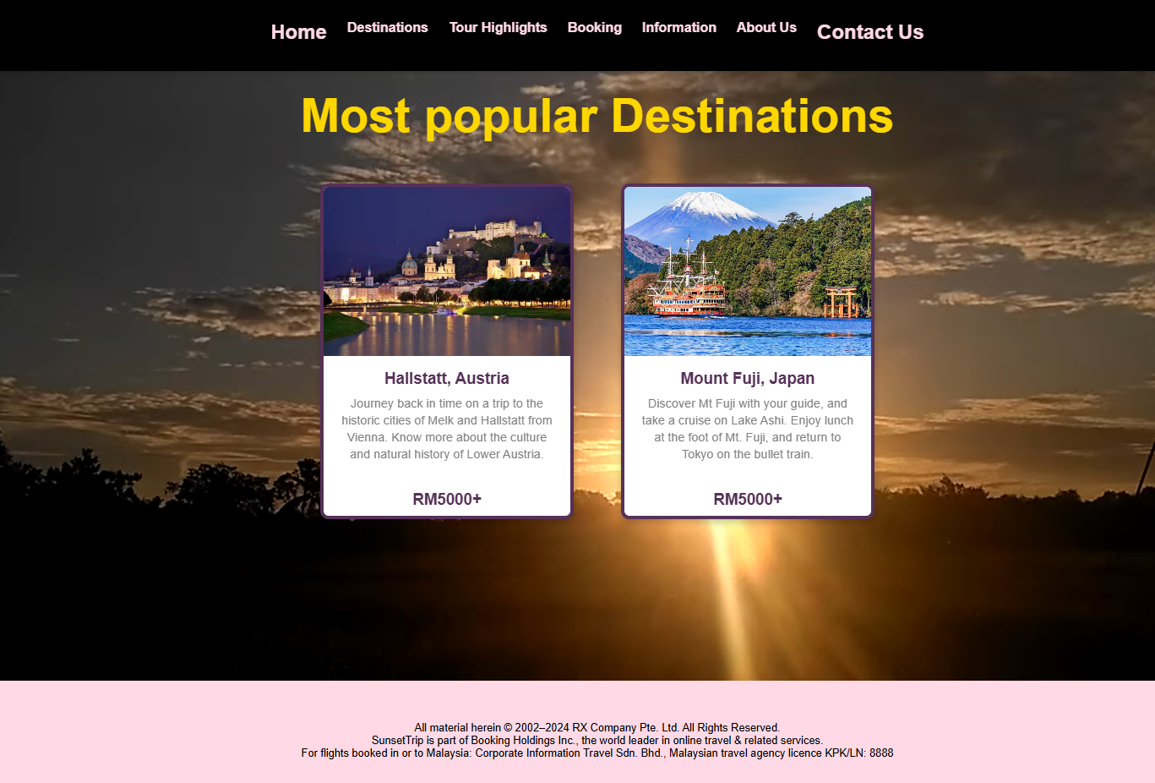
Second webpage
Explain the most popular destination and the estimated costs.

Slide 5
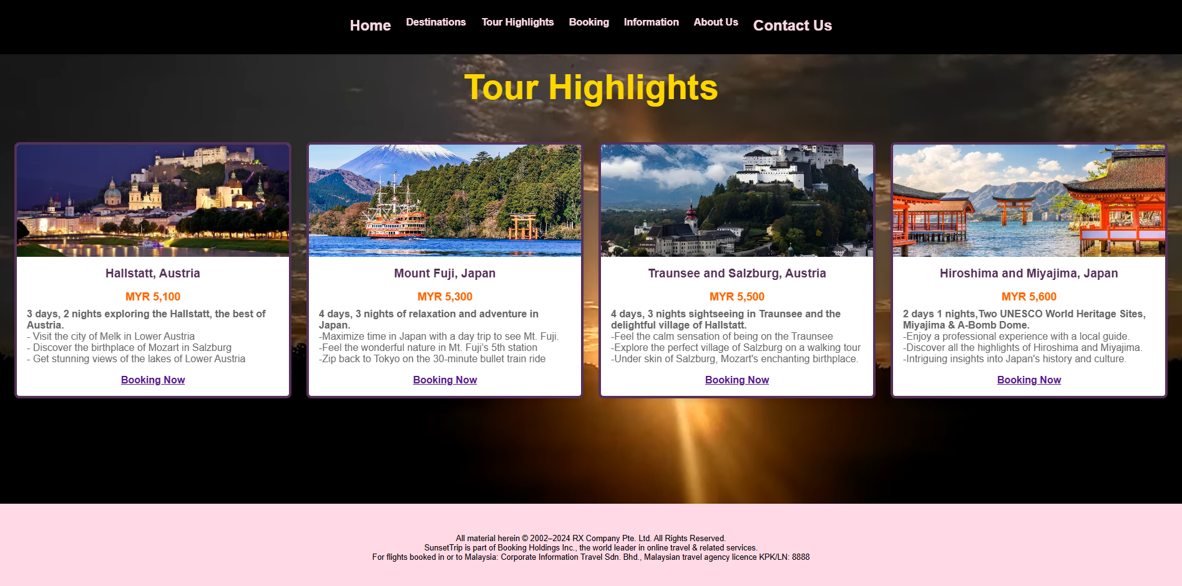
Third webpage
To show the detail of those packages and the highlights.

Slide 6
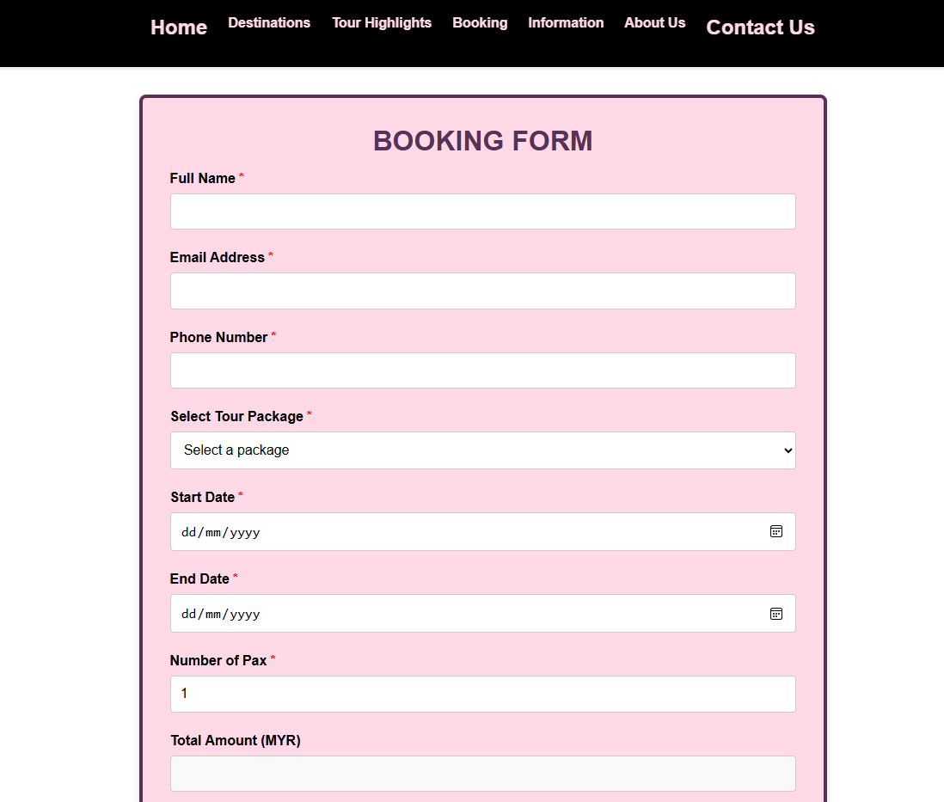
Fourth webpage
To provide a form for user to fill in personal information in order to book the trip.

Slide 7
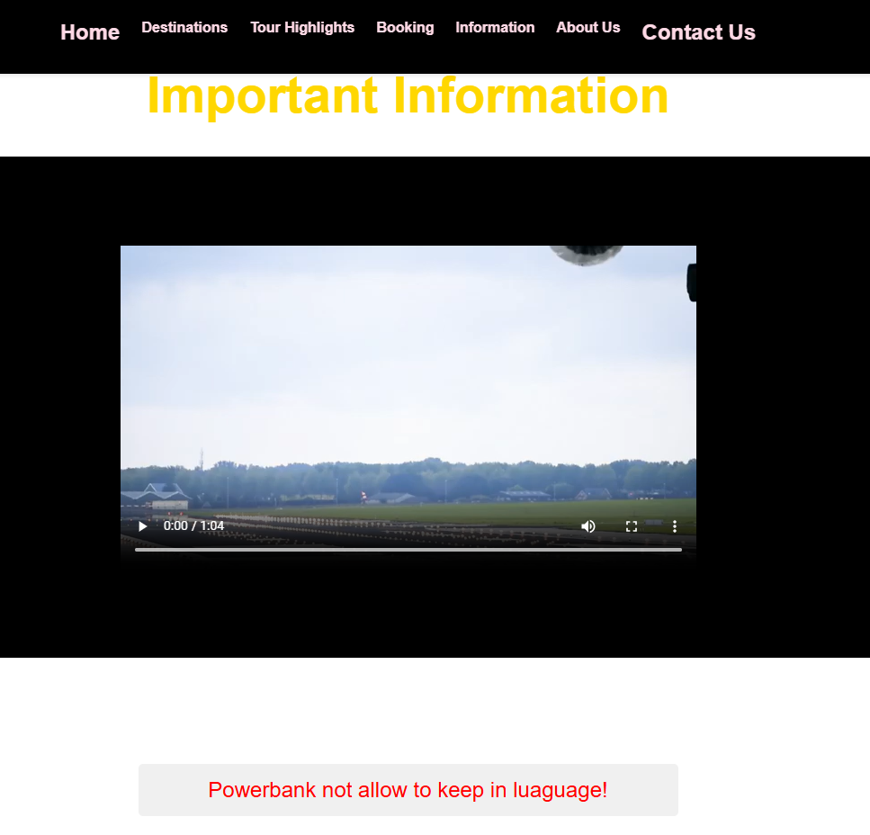
Fifth webpage
Provide a necessary note for potential users to remind them about custom clearance.

Slide 8
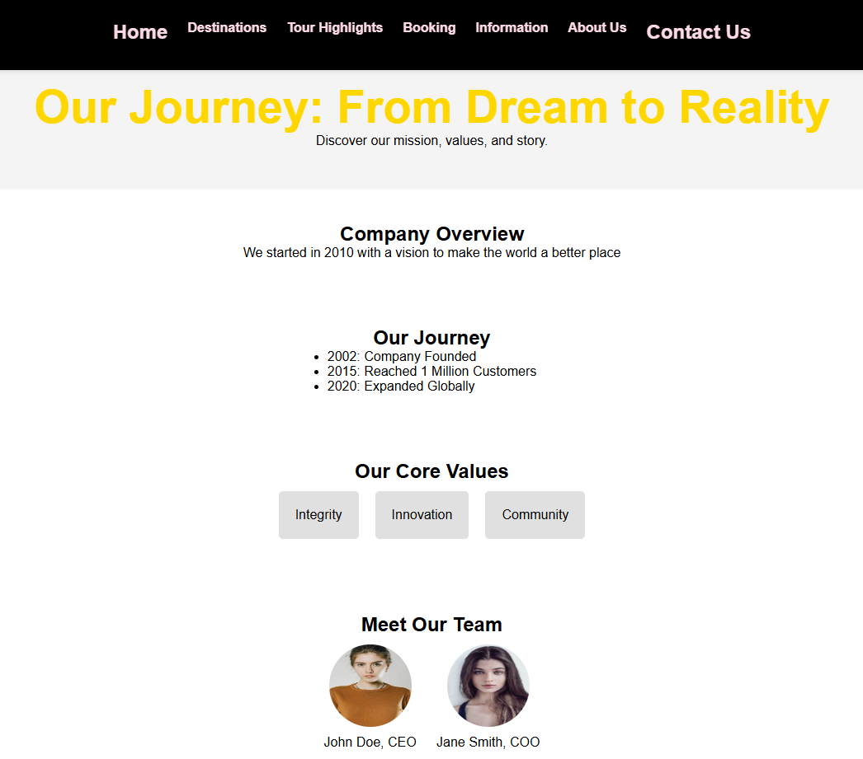
Sixth webpage
To build up the trust with users and provide an overview of company reputation.

Slide 9
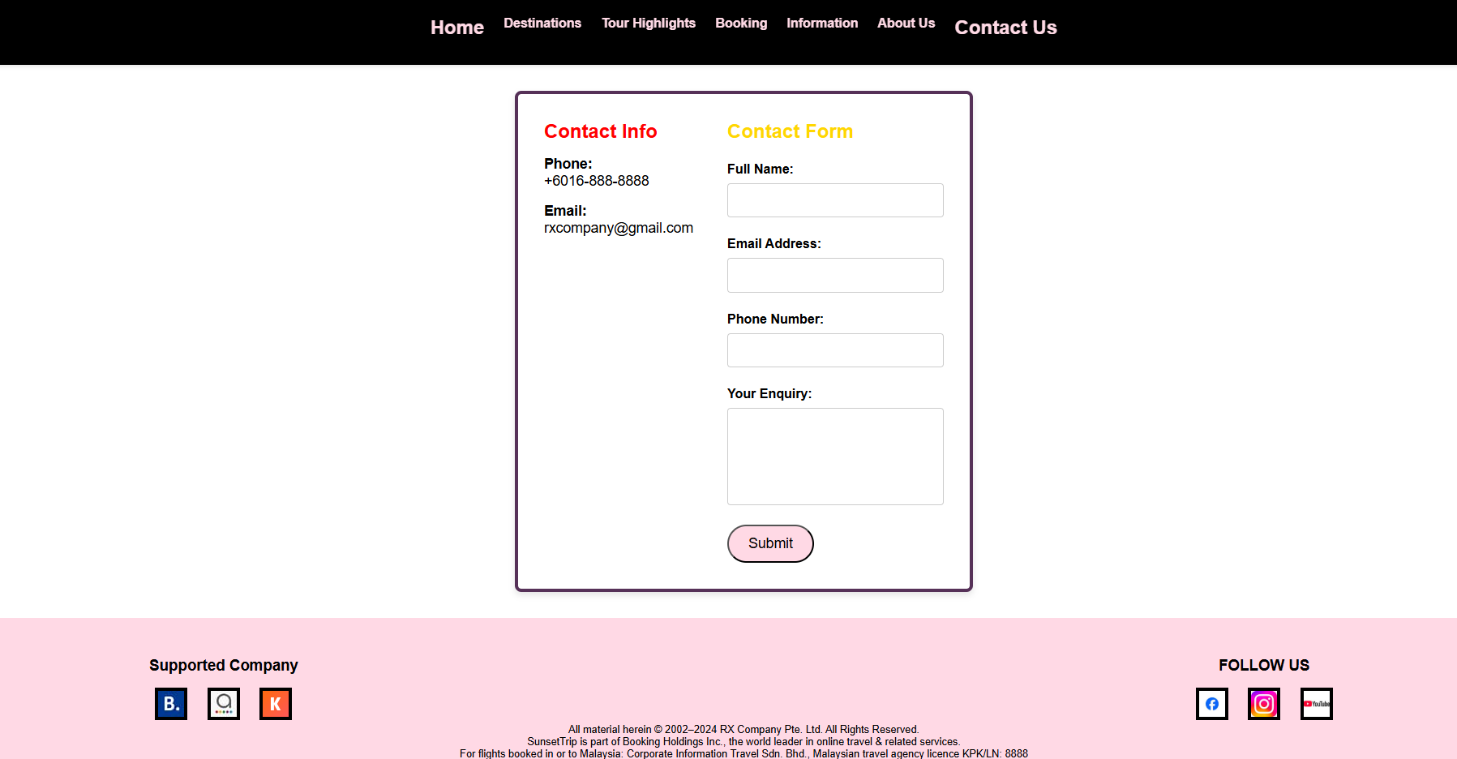
Seventh webpage
Provide contact info and a form for users to give feedback or enquiry.

Slide 10
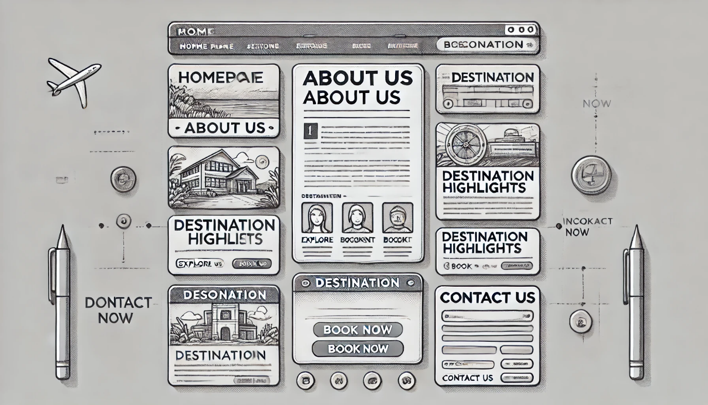
Sketch of website
This was the first look of my website that I searched it online.

Slide 11
Conclusion
A good tourism website does indeed inspire tourists with attractive pictures and stories while providing all the necessary information with full confidence in tour planning. Most importantly, it ensures accessibility on a variety of devices. Therefore, enabling users to access it at any time and any place for planning a wonderful trips.

